Slide 1
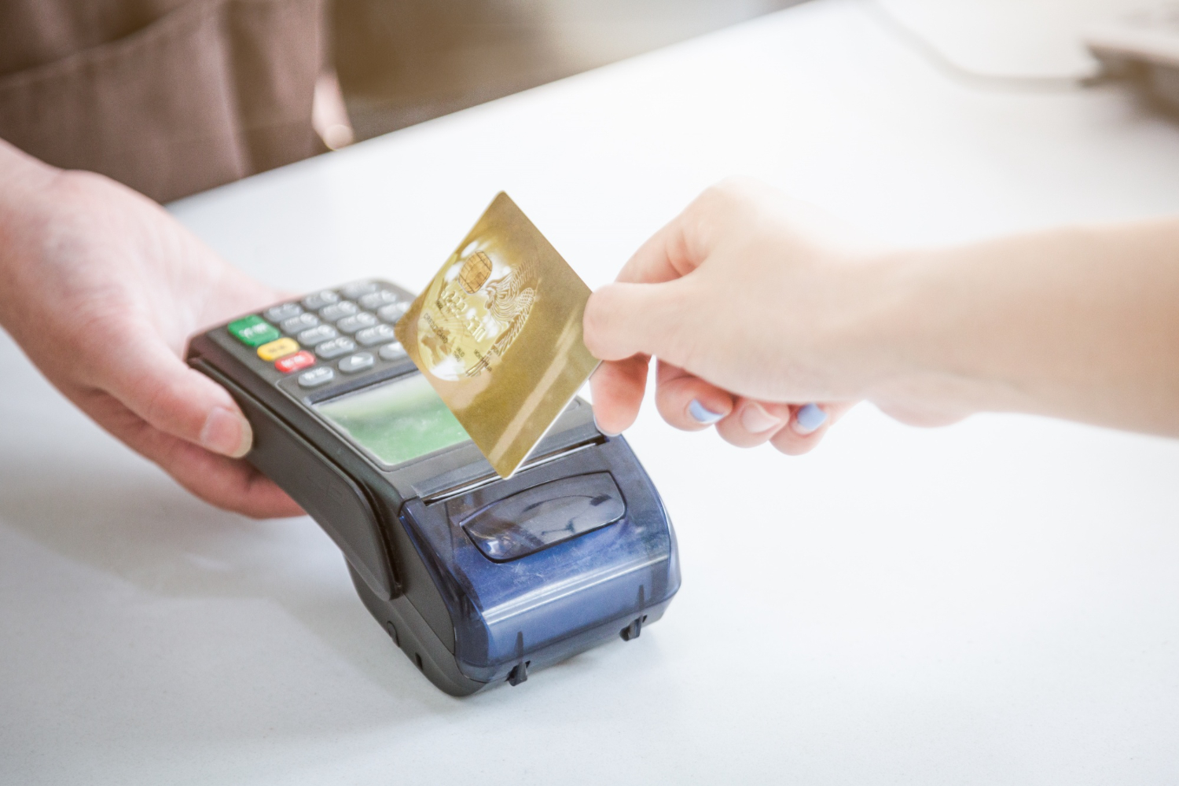
Credit card clustering

Slide 2
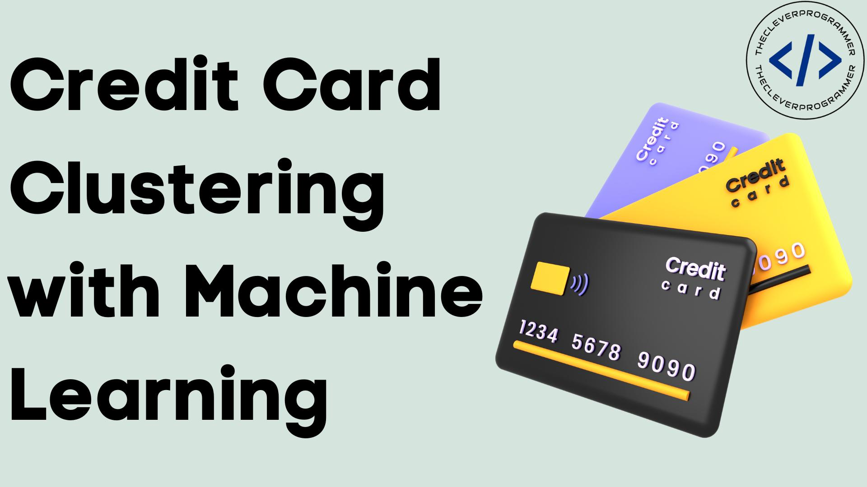
People also ask What is credit card clustering? Credit card clustering is the task of grouping credit card holders based on their buying habits, credit limits, and many other financial factors.

Slide 3

credit card is a physical payment card that allows you to get credit from a financial institution. You can use the pre-approved limit to make purchases and repay the borrowed amount with an interest each month within your billing cycle. What exactly does a credit card do? Credit cards let you buy now and pay later

Slide 4
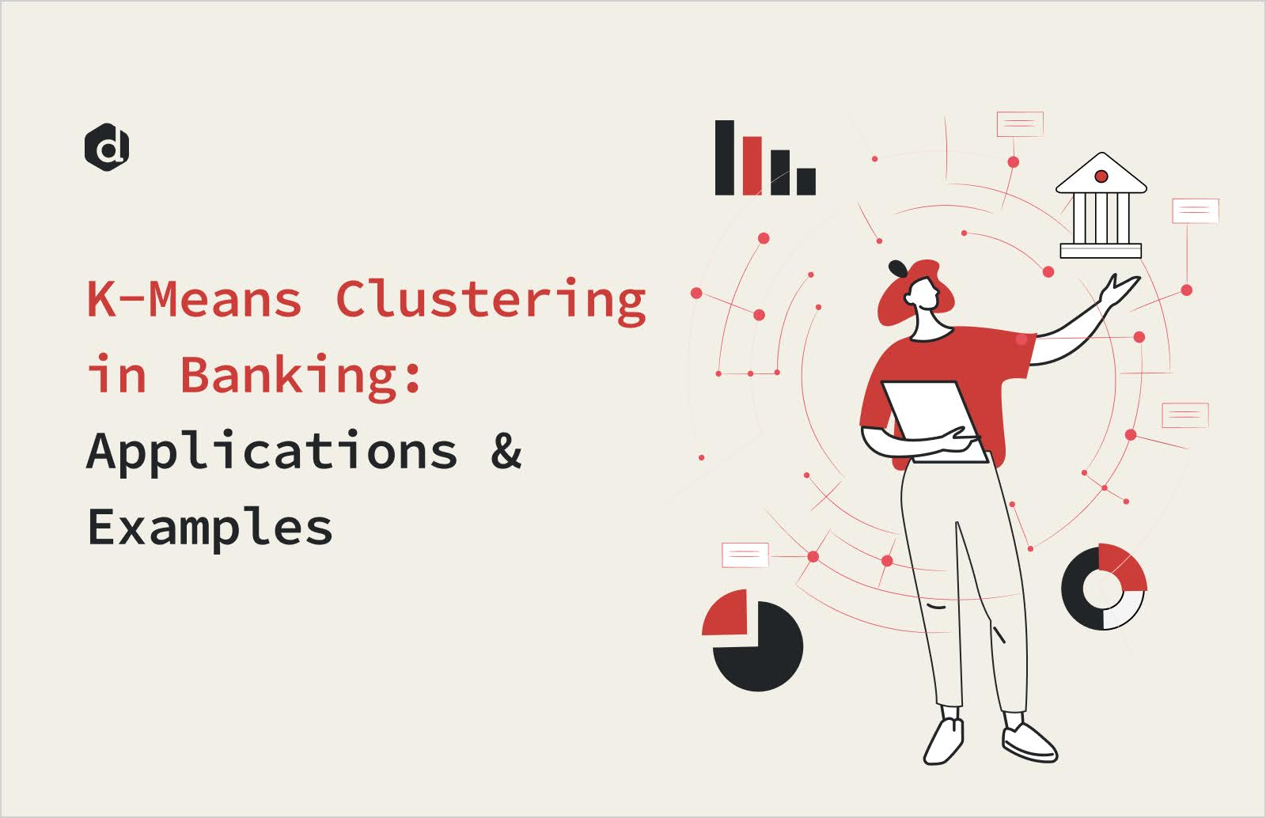
K-means clustering aids banks in identifying early warning signals of financial risk. By monitoring and analyzing data trends, this method can spotlight potential risk factors before they escalate into bigger issues. For instance, a sudden change in customer transaction patterns might indicate emerging credit risk.

Slide 5
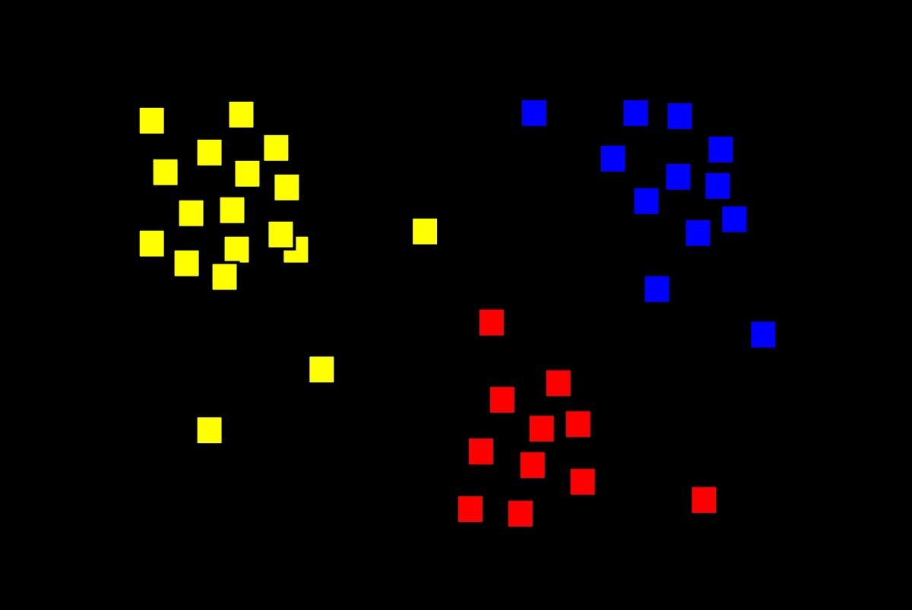
Cluster analysis or clustering is the task of grouping a set of objects in such a way that objects in the same group (called a cluster) are more similar (in some specific sense defined by the analyst) to each other than to those in other groups
Cluster analysis or clustering is the task of grouping a set of objects in such a way that objects in the same group (called a cluster) are more similar (in some specific sense defined by the analyst) to each other than to those in other groups

Slide 6
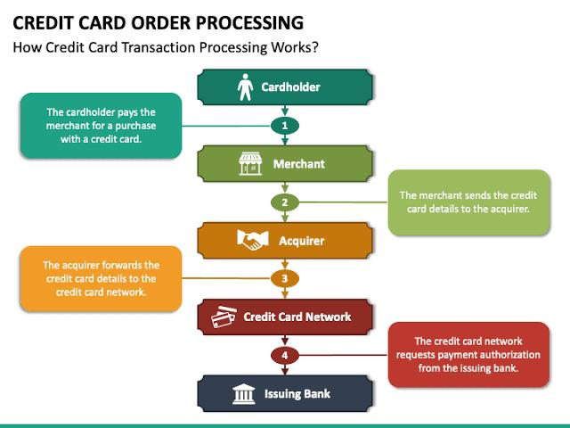

Slide 7
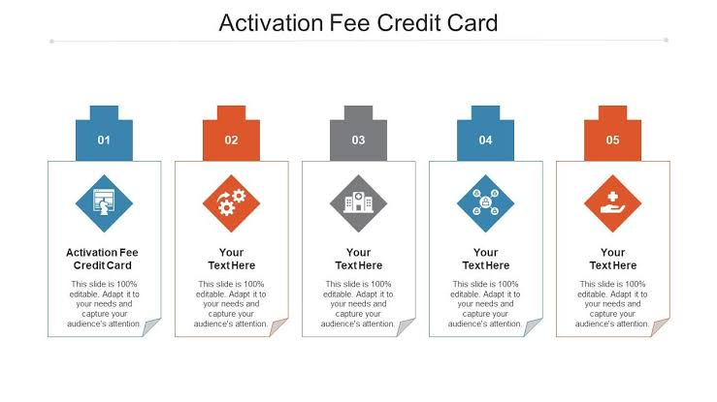

Slide 8
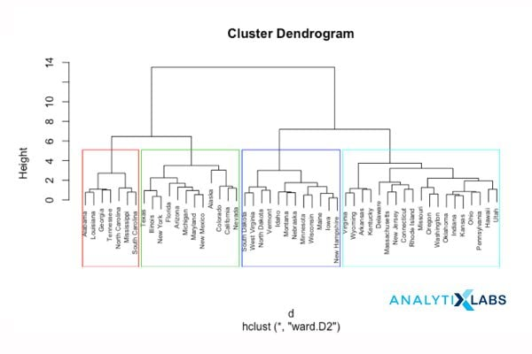

Slide 9
Best clustering method
The best clustering algorithm depends on your data’s characteristics and goals. K-means is popular for its simplicity and efficiency with large datasets. For non-linear clusters, consider DBSCAN. Gaussian Mixture Models are useful when clusters have different shapes and densities

Slide 10
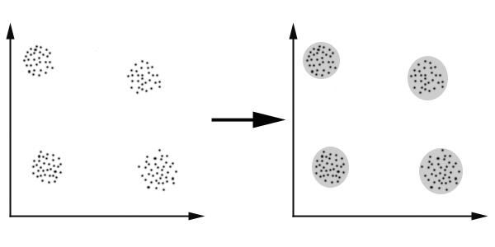
The main requirements that a clustering algorithm should satisfy are:
scalability;
dealing with different types of attributes;
discovering clusters with arbitrary shape;
minimal requirements for domain knowledge to determine input parameters;
ability to deal with noise and outliers;

Slide 11
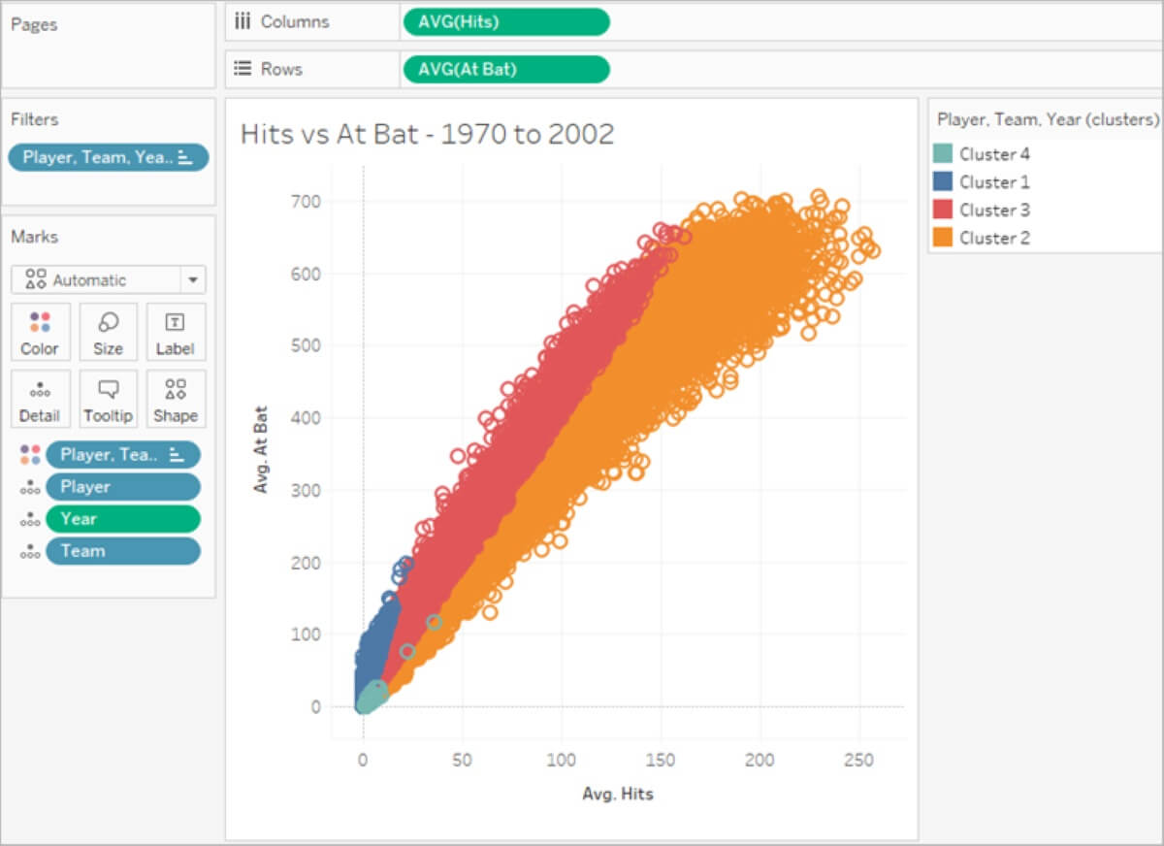
Clustering is a popular unsupervised machine learning technique used to group similar data points together. Clustering helps to identify patterns and structure in data, making it easier to understand and analyze.

Slide 12
Uses of clustering
The steps to do it are: Each data point is treated as a single cluster. ... Now we need to form a big cluster by joining 2 closest data points in this step. ... Two closest clusters need to be joined now to form more clusters. ... Repeat the above three steps until K becomes 0 to form one big cluster.

